Slide 1
Distribution

Slide 2
Place
Refers to how an organization will distribute the product or service they are offering to the end user.

Slide 3
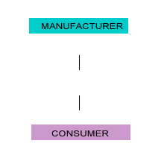
Methods of distribution (Channels)
Direct distribution
It involves distributing direct from a manufacturer to the consumer e.g. For example Handicraft

Slide 4
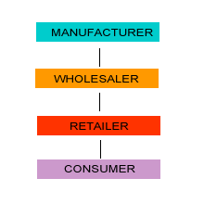
Methods of distribution (Channels)
Indirect distribution
It involves distributing product by the use of an intermediary.

Slide 5
Functions of channels of distributions
Possession transfer
Ownership transfer
Financial flow
Risk flow
Facilitating the exchange process
Matching buyer and seller
Providing customer service

Slide 6
Distribution strategies
Intensive distribution
Manufacturer try to distribute his product through as many outlet as possible
This is applicable to low involvement products
Soaps, biscuits, toothpaste

Slide 7
Distribution strategies
Exclusive distribution
It involves limiting distribution to a single outlet
This is done to deliver maximum service quality to the consumers
The product is usually highly priced
Here distributors cannot sell competitor’s products
Automobiles

Slide 8
Distribution strategies
Selective distribution
This falls between intensive distribution and exclusive distribution

Slide 9
Channel conflicts
Organizations like to control the business suppliers & distributor
But they cannot control them because of limited time, money and other resource
Hence they try to form relationship with them
But when they are not able to form relationship then conflict starts in them

Slide 10
Types of channel conflict
Vertical channel conflicts
This type of channel conflict occurs when channel members operating in different level compete for same market segment
GM wanted sell vehicle online which was protested by dealers
Horizontal channel conflicts
This type of channel conflict occurs when channel members operating at same level compete for same market segment
Franchisee s infringes his territory
Multi channel conflicts
When manufacturers form two or more channels for distribution and they compete for same market
When showroom and factory outlet compete for same market segment

Slide 11
Logistics
Logistics is process of delivering right product at right place in right quantity in right quality at right time

Slide 12
Factors determining choice of channel of distribution
Product related
Perishability
Nature of the product: Industrial product
Technicality : Medical equipment
Unit value: Diamond
2. Companies financial strength
3. Extent of control desired
4.Companies marketing policy
5. Past experience

Slide 13
6. Market related factors
Customers
Competitors
Existing channel of distribution
7. Business Environmental factors
Economic situation: Economic boom or recession

Slide 14
Promotions
Promotion is process of communicating information to the potential customer about products and its benefits
Objectives of promotions
Inform
Persuade
Remind

Slide 15
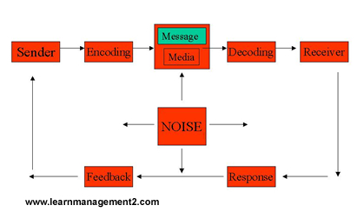
Communication process

Slide 16
Promotion tools

Slide 17
Advertising
It is paid form of non personal tool of promotion
It is used to reach consumer at low costs
It is goods for low involvement products
In case of high involvement product where considerable amount of explanation is require it plays supporting role

Slide 18
Sale promotions
Sales promotion is generally used to attract customers by offering them various benefits in form of incentives
It includes coupons, discounts, free samples etc
It is generally done to do boost short term sales

Slide 19
Publicity
Publicity is non paid form of promotions
It communicates information about company or it’s products or both through a news articles in news papers, TV, Radio etc
It generates greater attention than ads & people give more importance to publicity than ads

Slide 20
Public relations
It is done to generate goodwill for the organization
It creates positive environment for firms
Organization can develop public relations with several member supplier, customer employees , share holders, governments, distributors, members of publics
It does not help immediately but helps in long term
Annual report , Notices, Press conference

Slide 21
Personal selling
Here products or services are sold directly to the consumers
It is highly specific with regards to the target audience
The costs involved is high since sells person has to meet personally to the customers
It has high impact on customer and feedback is also immediate
It is generally done for high cost product because of it is expensive in nature

Slide 22
Direct marketing
In direct marketing organizations directly communicate to customers through e-mails, telephones , sms etc
Amway is global giant in direct marketing with 450 products and operating over more than 80 countries

Slide 23
Integrated Marketing Communications Planning Model
Marketing Plan
Decide target audience for communication
Budget Determination
( Competitive parity ,Affordability , % of sale)
Develop Integrated Marketing Communications Programs
Advertising
Sales
Promotion
PR/
Publicity
Personal
Selling
Direct
Marketing
Advertising
Objectives
Sales
Promotion
Objectives
PR/
Publicity
Objectives
Personal
Selling
Objectives
Direct
Marketing
Objectives
Message
Strategy
Sales
Promotion
Strategy
PR/
Publicity
Strategy
Personal
Selling
Strategy
Direct
Marketing
Strategy
Integration & Implementation of Marketing Communications Strategies
Monitor, Evaluate & Control Promotional Program
© 2003 McGraw-Hill Companies, Inc., McGraw-Hill/Irwin
Notes:
Relation to text This slide presents the IMC Planning Model which is shown in Figure 1-4 and discussed on pp. 25-32.
Summary Overview This slide presents the IMC Planning Model which is discussed in detail in Chapter 1. This model presents the framework for developing, implementing, evaluating, and controlling the firm’s IMC program and activities.
Use of this slide This model should be reviewed very carefully at the beginning of the course to show students what is involved in the development of a complete IMC program. It presents the framework that is used for the text and provides an opportunity to provide students with the “big picture” and a roadmap of what will be covered in the course.

Slide 24
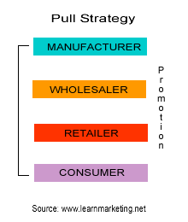
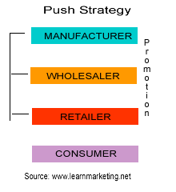
Push & Pull Strategies

